Slide 1
OSM Student Training Guide
TeachOSM

Slide 2
1 OSM Account Creation
getting the show on the road

Slide 3
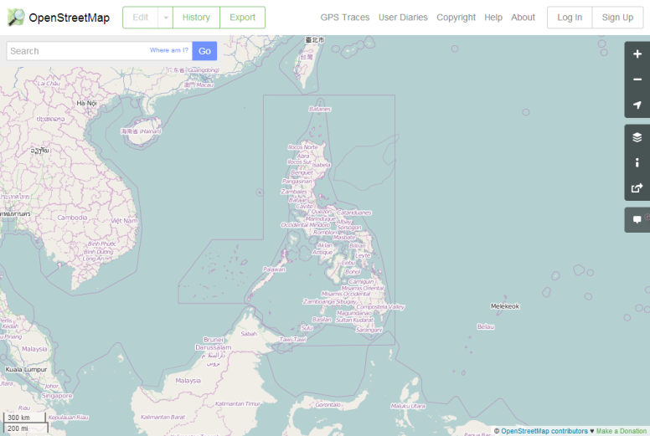

Open Street Map
Notes:
This is what the OpenStreetMap page looks like when you first go to their page.
Here we’ve focused the map on the Philippines.
To contribute to OSM you must have an account. Accounts are free and only take a few moments to create.
Click the ‘Sign Up’ button in the upper right corner to start the process.
Enter your email address and Display name. Your display name is anything you want it to be and will be associated with every edit you make in OSM.
You will need to provide this OSM display name to your instructor.

Slide 4
2 iD Editor
the in browser editor

Slide 5
iD Editor
Click on the Edit button on the top left hand corner of the OSM map window
Go through the iD Walkthrough tutorial
Practice some editing in an area that is familiar to you

Slide 6
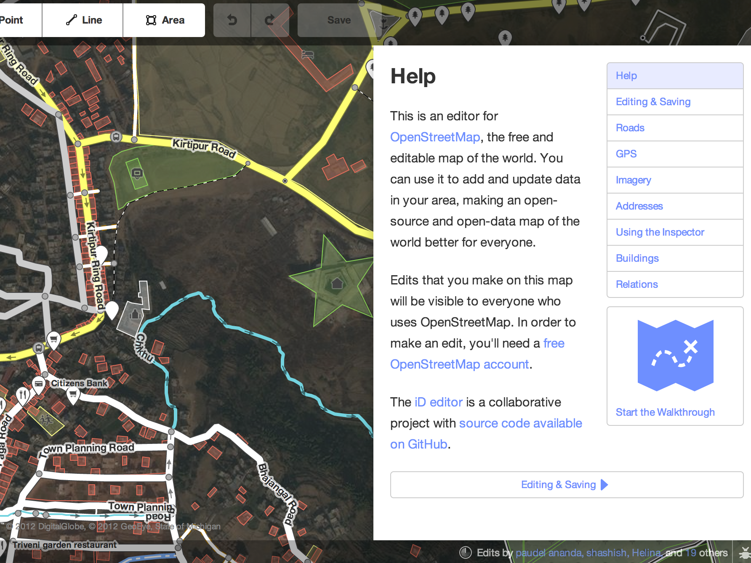
iD Editor
Use the (short) built-in walk-through to demonstrate how to trace
Notes:
If you need a reminder how to use iD, you can make use of the Walk Through at anytime.

Slide 7
3 OSM Tasking Manager
collaborative mapping project interface

Slide 8
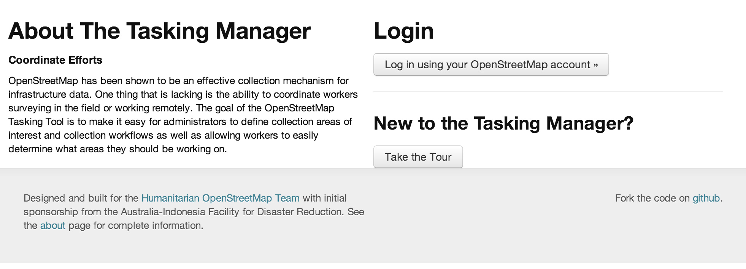
Tasking Manager
Link: http://tasks.teachosm.org/
Notes:
OpenStreetMap has been shown to be an effective collection mechanism for infrastructure data. One thing that is lacking is the ability to coordinate workers surveying in the field or working remotely. The goal of the OpenStreetMap Tasking Tool is to make it easy for administrators to define collection areas of interest and collection workflows as well as allowing workers to easily determine what areas they should be working on.
HOT – Humanitarian OpenStreetMap Team
Admin sets up tasks to be worked on collaboratively (must have admin privileges)
Anyone with a regular OSM account can use it

Slide 9
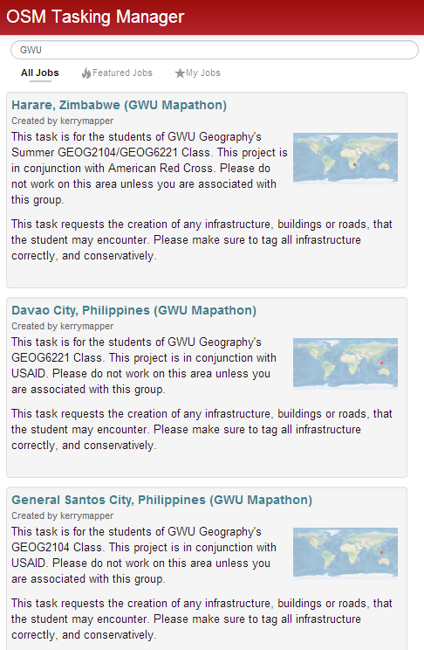
OSM Tasking Manager
Log in with regular OSM account information
On the main page click on All Jobs, and search for your assignment using a key word
Notes:
The first this you need to do is log in to Tasking Manager with your OSM credentials.
You now see the JOBS page of TM. To find the jobs for your assignment, select the ‘All Jobs’ tab at the top of the page and then search for your job in the search bar.
Click the Job for your class assignment.

Slide 10
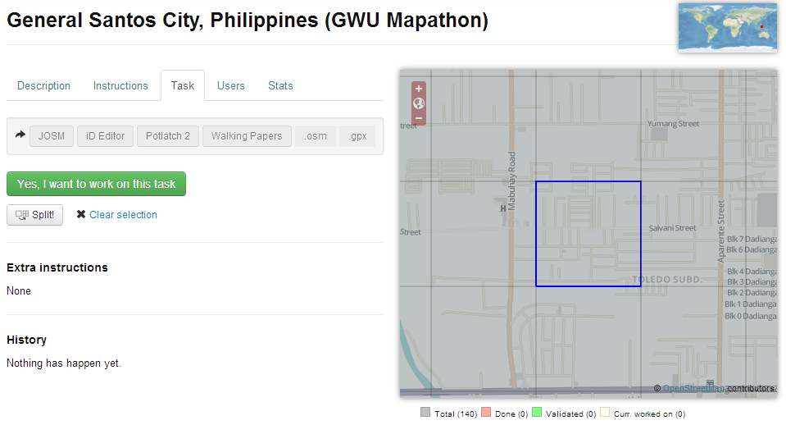
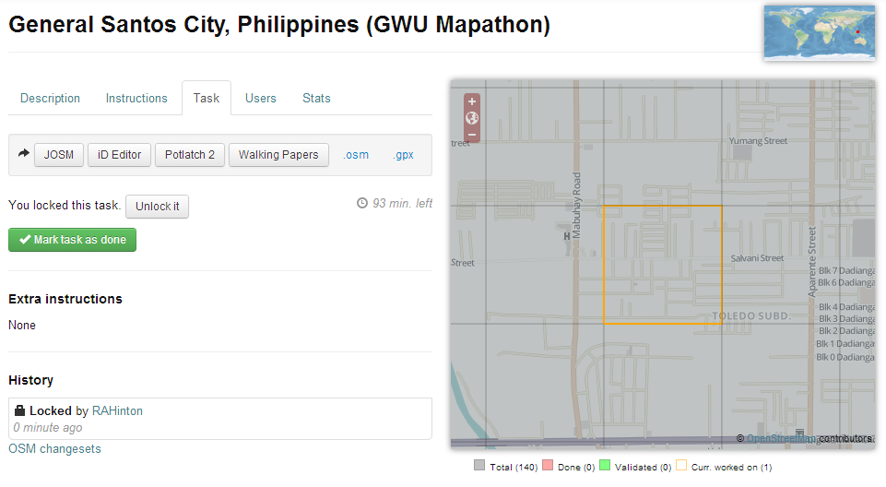
Notes:
PROVIDE TASKING MANAGER DEMO: Guide the students through the task interface
Description and Instructions tabs mimic what we cover in training, but it’s good to have here for documentation purposes.
Zoom in on the map on the right
Select a tile
If it looks really busy, then you are welcome to split it, but be careful – do not split more than once (you cannot recombine)
If your are happy with the tile you’ve selected, click the green button ‘Yes, I want to work on this task’
This will ‘lock’ the tile so no one else can select it and turn the blue square orange, indicating that someone is editing it.
Next, Choose iD Editor as you favorite editing tool, and iD will launch automatically in a new tab, and draw a pink square around the area chosen in Tasking Manger.
If you look at your square in iD and it’s still looks too complicated, you check it back in, and you can split it in Tasking Manager, and check out a smaller portion of that same area. There is no undo for this operation!! But if you feel it would help you manage that cell then do it and then exhaust all features in that smaller cell.
Once you’ve traced all you can in a cell, mark it as Done but only if ALL features have been traced. If there are more features to trace, but you have met you quota or you cannot determine how to trace more features, then Unlock it so someone else can work on the cell.

Slide 11
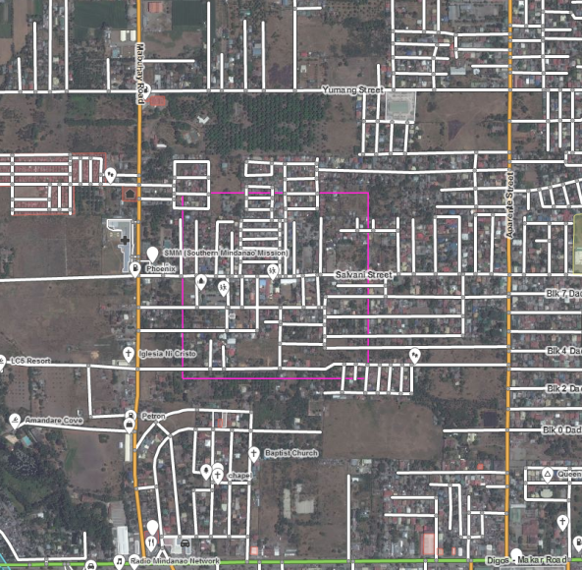
Selected Cell in iD
Stay within the pink box
Trace ALL features possible
Once complete, mark as Done or Unlock it for others to work on it in Tasking Manager.
Choose cells close together
Notes:
Now you can start tracing features, but stay WITHIN the pink box!
Once you’ve exhausted all of the features you can tracing in that cell, either Unlock it OR if ALL features have been traced, you can mark is as DONE, but ONLY if ALL features have been traced.
When you have done what you can with a cell (have unlocked it or marked it as Done) but have not met your quota, go back to Tasking Manager and choose another cell, as close as you can to your first cell.
We want you to work in the same part of the city.

Slide 12
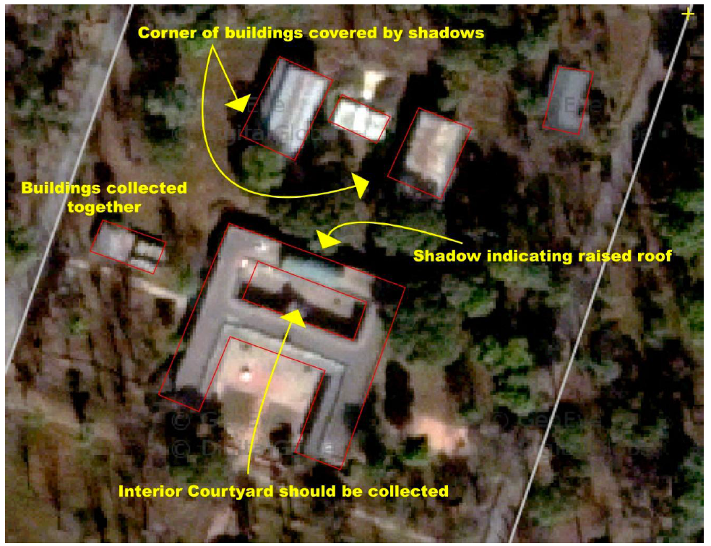
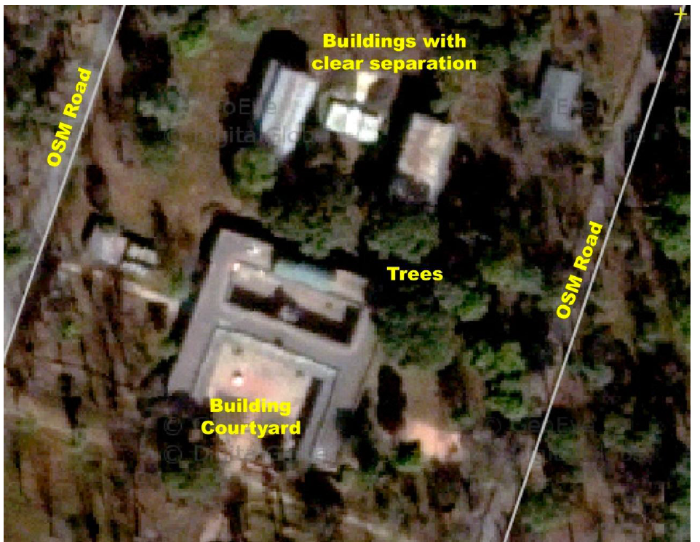
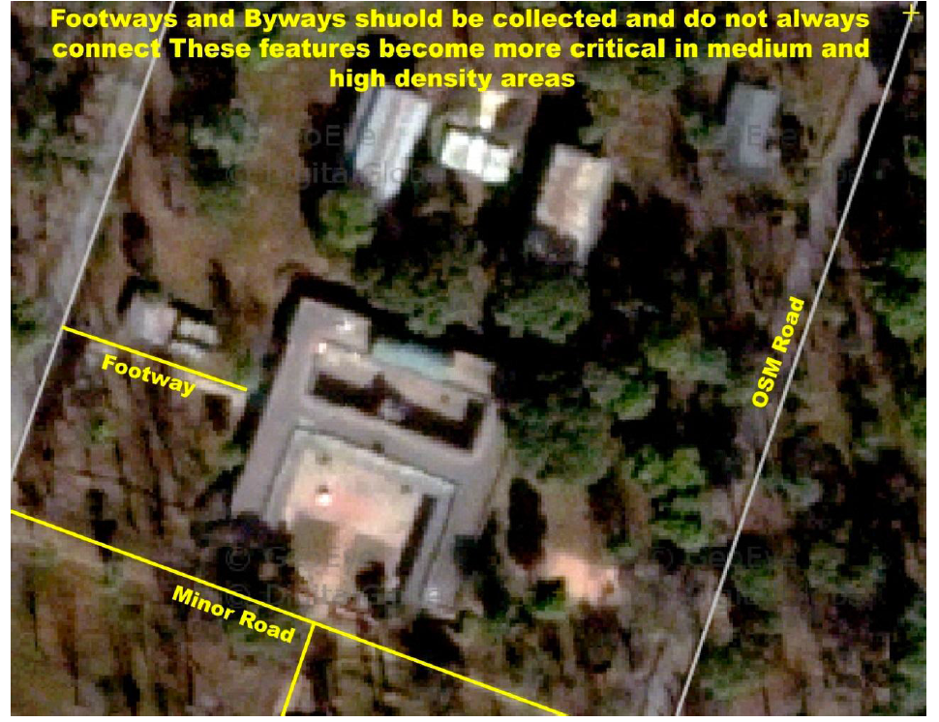
Tracing Examples: Low Density Areas
Low Density Areas: Small footways are clearly visible surrounding the main building. Footways often do not connect so it is acceptable to add dead end lines. Only connect paths when their intersection is clearly visible.
Notes:
Low Density Areas: Low density areas are places within the city which have features surrounded by large areas of open space and are the easiest place to begin tracing. In low density areas tracers should begin training their eyes to study shadows, which indicate the sun direction. Care should be taken to trace the building footprint rather than placement of the rooftop. In some cases you can see the side of taller buildings and the roof is offset from the existing footprint. For an in-depth look into roof modeling, this wiki does an excellent job explaining common interpretation errors associated with building roofs and shadows. In the low density environment tracers should be aware of roof features which can trick you eye in determining the true shape of a building. In Kathmandu is it common for rooftops to be flat and have features such as additional rooms, covered awnings, and water tanks on top.
TEXT FOR POP-UP IMAGE
Small footways are clearly visible in this surrounding the main building. Footways and pathways often do not connect so it is acceptable to add dead end paths. Only connect paths when their intersection is clearly visible.

Slide 13
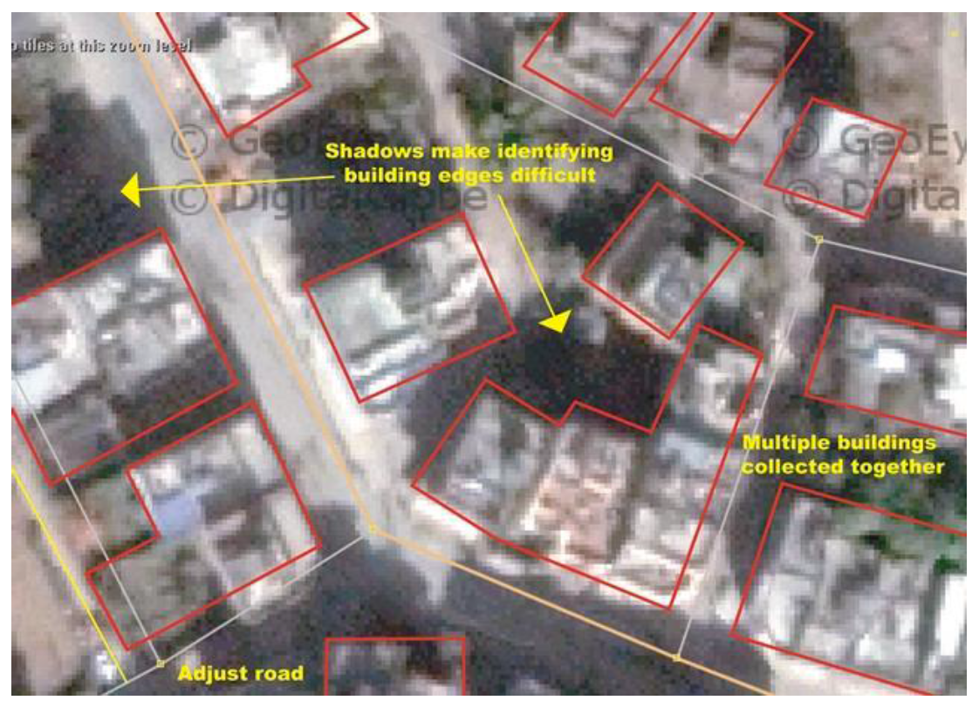
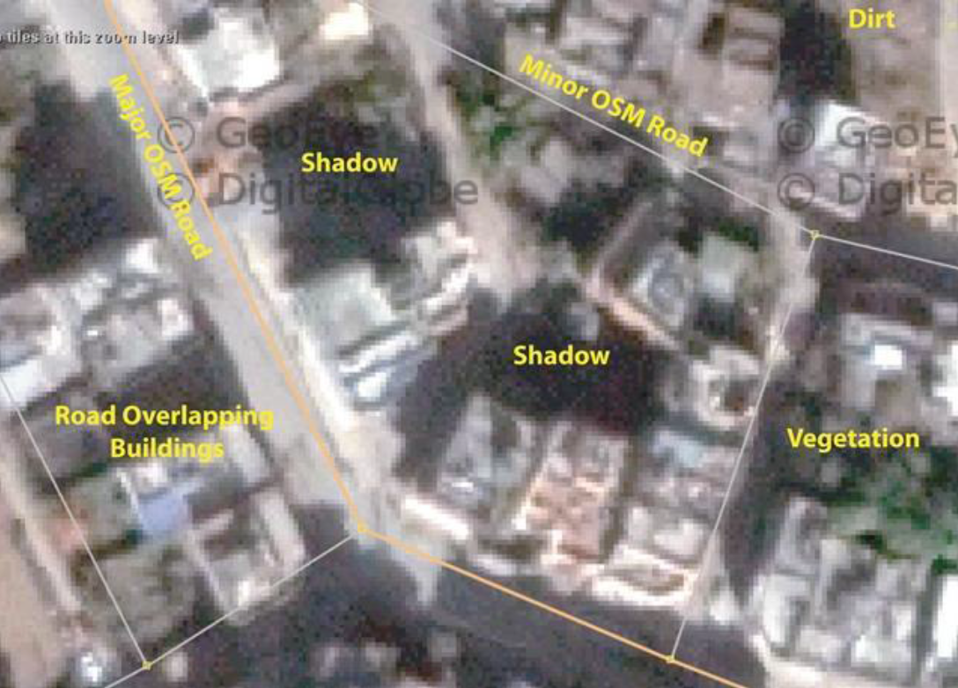
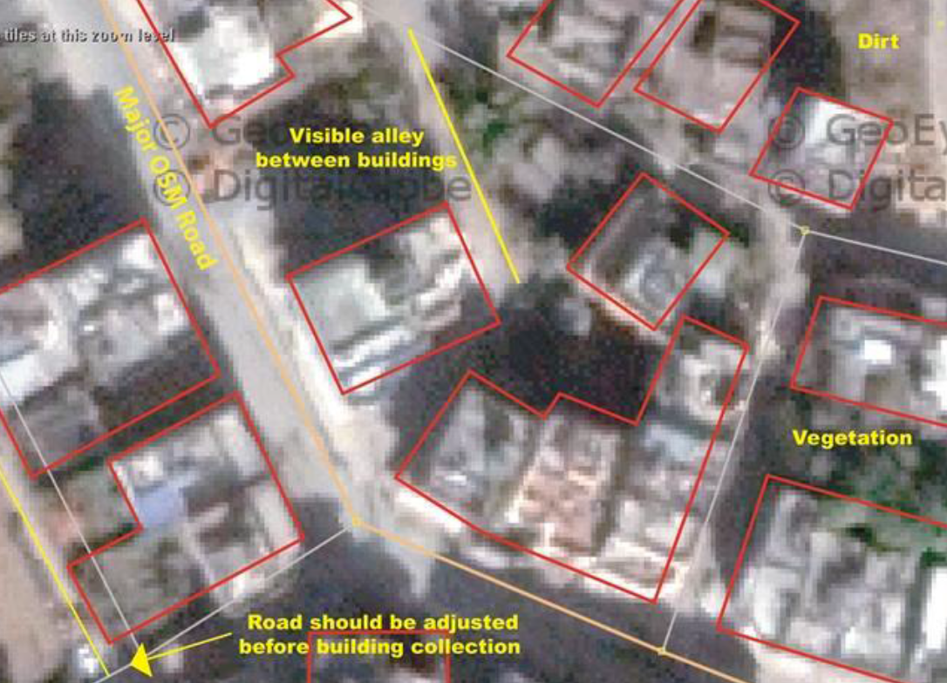
Tracing Examples: Medium Density Areas
Medium Density Areas: Here is a visible alley between buildings which is easy to identify due to the wide space between buildings and its color, texture and shape. In reality alleys do not always connect with other alleys/roads and the tracing should represent the reality of what a user can positively identify in the image.
Notes:
Medium Density Areas: Medium density areas introduce footpaths between tightly spaced buildings. Footpaths should be collected when they are clearly identified. Footpaths do not always connect and it is acceptable to stop tracing at a dead end. Searching for footpaths and shadows between buildings will help a user in delineating building mass. Buildings are often interconnected and built at different heights. When a user can not identify a clear break between buildings, they should be collected as one. Most buildings in medium density areas have right angles making their edges easier to identify. It is helpful to use multiple source images to have another perspective of the area.
TEXT FOR POP-UP IMAGE
Note how interconnected buildings were collected as one. Building footprints should be delineated by building edges, often identified by looking for geometric angles and large shadows. If a user is unable to identify a building in the image due to shadows or other variables, the space should be left empty. In these cases it can be helpful to use multiple imagery sources.

Slide 14
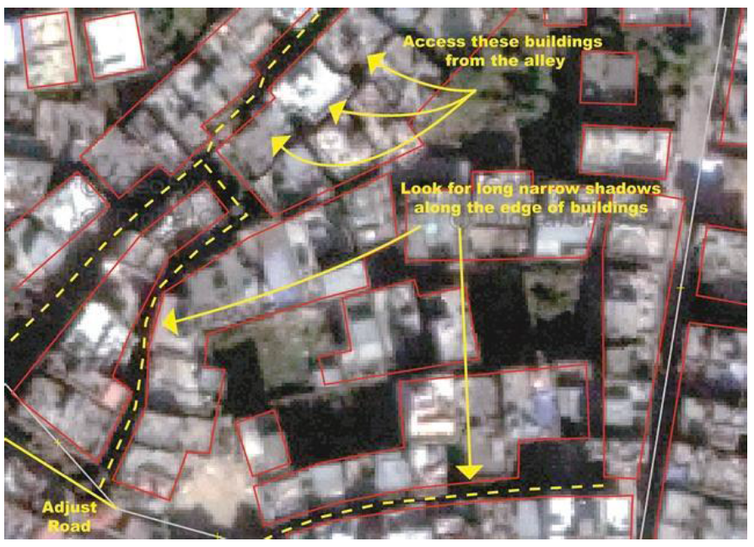
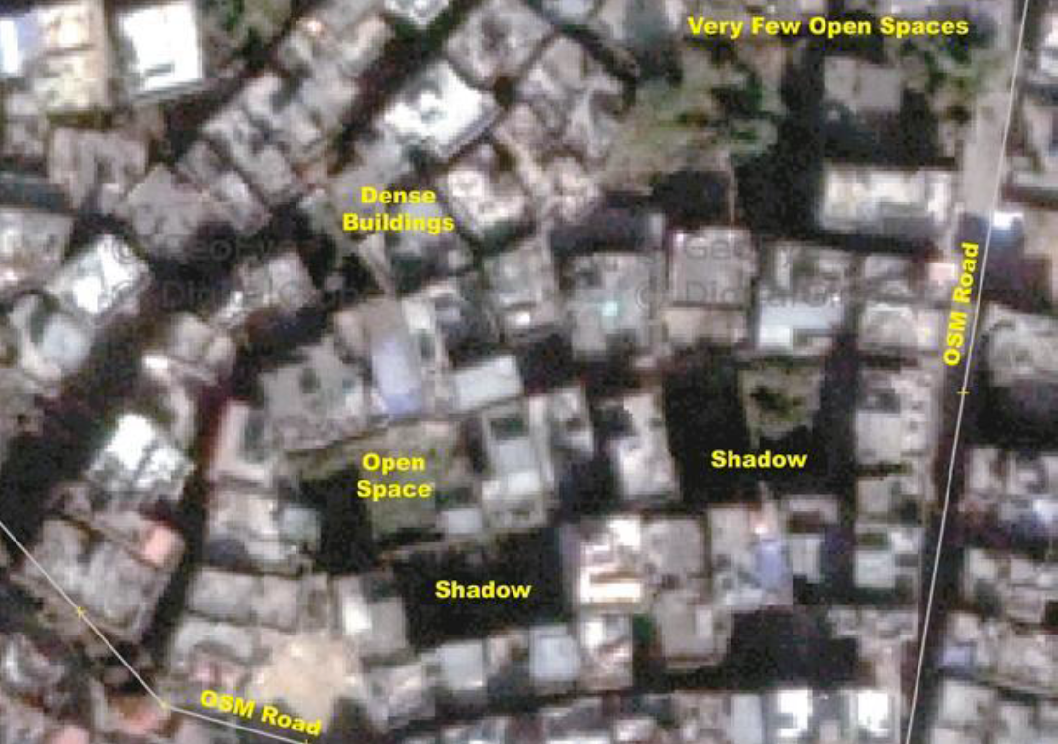
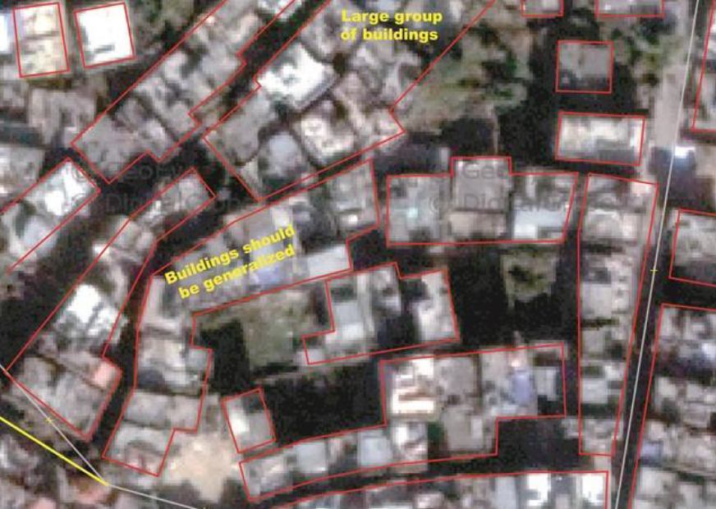
Tracing Examples: High Density Areas
High Density Areas: Study the image below of a high density area and look for logical roads and alleys by identifying building shadows and empty spaces. These features should be collected if a user is able to accurately determine their location. It is better to not collect an alley then to collect one which does not exist.
Notes:
High Density Areas: In high density areas of Kathmandu there are very few open spaces and entire sections of the city between roads are built up. Every building is accessible, most by a narrow alley only a few meters wide. These are the most difficult areas to collect and should only be attempted once a user has had the opportunity to condition their eyes by collecting low and high density areas. You will find large areas consisting of dense interconnected buildings of various shapes and sizes. Users should begin by studying the area and identifying shadows and logical footways between buildings. Look for signs of flat areas such as roadways and packed dirt. Identifying flat areas that do not cast shadows is helpful in determining footways and building footprints. Again additional imagery sources are useful to have another perspective.
TEXT FOR POP-UP IMAGE
Identify building edges by studying shadows and looking for open spaces. In high density areas buildings are randomly placed and have varying heights making extraction very difficult. When buildings are interconnected they should be collected together and often do not have right angles. It is common to not have perfectly square buildings in high density areas.

Slide 15
Editing and tagging
SAVE your edits after each piece of infrastructure to avoid mapping conflicts
TAG every piece of infrastructure
Add a commit message:
#YourOrganization tracing source: Bing
It’s a good idea to maintain an Edit Log document
Note interpretation issues (with screen shots)
Workflow frustrations
This helps improve student workflow and user experience
Notes:
Be sure to save your edits after each piece of infrastructure to avoid mapping conflicts.
As well, you must tag (or attribute) every piece of infrastructure you create.
When you click save, you will be prompted to add a ‘commit message’. This text is used to identify some general information about who is working on that edit, and the source of the tracing. For example you will be using bing imagery for your tracing – it’s the default imagery for OSM. Therefore, for this project we want you to include the following information with your commit message every time to click save.
#YourOrganization tracing course: Bing (it’s very important to include the tracing source so that others that work around your traced features will know the source)

Slide 16
Marking Complete with Tasking Manager
When you have completed your chosen cell, make sure to mark it as DONE in Tasking Manager, with a note to describe the work you did
(this can be a repeat of the commit message with any additional detail you think might help)
If you’ve done all you can do in a cell and it is not complete, Unlock it!
DO NOT mark an incomplete cell as complete
Notes:
Once you’ve exhausted all of the features you can tracing in that cell, either Unlock it OR if ALL features have been traced, you can mark is as DONE, but ONLY if ALL features have been traced.
When you have done what you can with a cell (have unlocked it or marked it as Done) but have not met your quota, go back to Tasking Manager and choose another cell, as close as you can to your first cell.
We want you to work in the same part of the city.

Slide 17
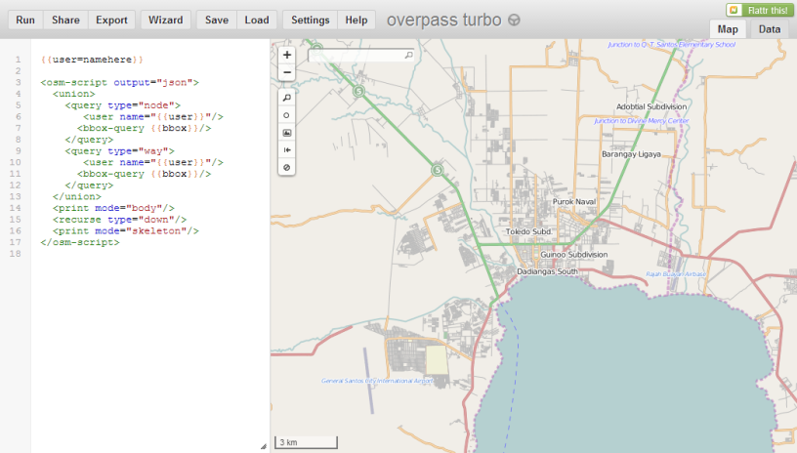
Tracking your Work: Overpass Turbo
http://overpass-turbo.eu/
Notes:
To track your work you can use Overpass Turbo.
This is an open source application that works with OSM.
Simply use the Wizard button at the top of the page and search for your OSM username. Using the syntax user:your_osm_name
Your edits will be highlighted on the map and the total count of your edits will appear in the lower right corner of the window.

Slide 18
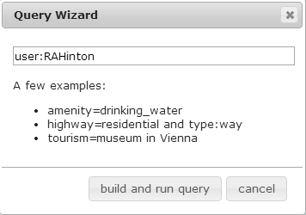
Overpass Turbo
With overpass turbo you can run Overpass API queries and analyze the resulting OpenStreetMap data interactively on a map.
http://overpass-turbo.eu/
Navigate to the area your are working
Click the Wizard button
Use the following syntax to search for your OSM edits:
user: your_osm_name

